Slide 1
FX Regional Model for OJK

Slide 2
Brief on OJK
Under the T&M OJK onshoring project, presently the scope , cost approval is with with RET-DOL as an app code.
There is a regulatory bound timeline , whereby Murex Indo needs to be live by Q2, 2021 and the OJK core project team is looking at a big bang go live (as all front end systems like Murex, RET, TRAX, Digimarkets) are interconnected. Thus , SIT minimally needs to start by late March 2020.
Initial analysis is done on FX regional booking model by using in house apps and discussion to be done on whether this can be implemented in Indo as part of OJK project.

Slide 3
FX Flow - High-Level TO-BE system flow [Full system solution]
Customer data file
Customer data file
External
agent banks*
ET2 SG
FINACLE ID
CIF + Tier file
Globesend
Market rates
Board-rates publishing
BRS
Flexi FX
Hi-P
UB Lite
DCC*
Limits sync
Limits
connector
MLC
FX rates
FX tiers
Limits
Check/
chalk
Deal Blotter
Limits
chalk
Manual booking
Streaming rates
digimarkets
Market Ops
Accum
TPS
MUREX
TAPI
KAFKA
IDEAL
New
DOLWeb
Pricing, Deal booking
IP/
SOI
Deal booking
TRAX
Deal & Mkt ops flow
IBG/CBG
Channels
(IMEX, IPE,
Digibank)
Transformation
Layer
IP/
SOI
Pricing, Deal
booking
Deal & Mkt ops flow
OPAL
Deal Booking, Deal Utilization
Deal Utilization
ORP
(Recon TBC)
Systems Confirmed to be onshored to Indonesia
Possible systems to onshore to Indonesia in new Regional FX model
Systems to be in Singapore
* Possible system to be kept in SG. (further review from Indo needed)

Slide 4
 | Pricing/Rates engine and Customer Tiering
 | TAPI/FLEXI/Hi-P | New DOLWEB
Day 1 - MVP (Sept 2021) | Flexi FX to be the pricing engine - Pricing to be directly taken from ET2 SG Providing RFQ rates to IBG/CBG systems - SOI to make changes to point booking & pricing requests to TAPI (similar to SG Globesend flow) FlexiFX V1 version can be implemented where pricing will be from FlexiFX (FlexiFX book RFQ to TZ), however booking will be done through IPE/SOI to TZ/TRAX Customer Tiering - Will be in Hi-P like what is happening in SG & HK under Globesend Board-rates publishing to IBG/CBG systems - Use BRS (like for SG under RUSP migration) to publish to IP/SOI Manually quoted deals function to be supported - Sales can tweak the market rates coming from the RFQ and submit deal. Includes Back-dated deal booking. This will be developed on Digimarket. If prices to FlexiFX through ET2 SG, Indo trader will be able to perform following functions on ET2 Skewing/Widening of rates Enhancement for reporting FCY/IDR deals to BI Sysmontavar - Reuters has connectivity to Sysmontavar - With no ET2, TAPI will provide a feed to Reuters Trader quoting panel for Sales manual quoted deals. Understand when sales enter a manual ticket, it gets routed to trader on ET2 for pricing - to use Sales manual deal-booking on Digimarket (need to get concurrence from Indo traders/bms.) Active deals blotter - Traders can pick-up even an auto-quoted deal in ‘Negotiating’ status and choose to reprice it . - The deals will still STP. Again, need Indo traders/ms to advice if this is really required/used or can be replaced. Order Watch – understand currently orders are entered into Indo ET2 instant - Continue to leave orders in ET2 SG and upon fulfilment, deals booked manually by sales dealers in digimarket. They may need to use fictitious rather than real customer details when putting the order on ET2 SG Flexi to send Finacle mid rate and maintain Indonesia rate page Assumptions : No Portals in Indo 2021 | DOLWeb Tightly coupled with core ET2 today Will need to be re-built and will be one of the major pieces User management – check user id, status, CIF number…etc User preference and permission – view rate/trade, selected ccy pairs, languages Maintain available ccy pairs list and tenors, Calculate and check daily notional limit for VSD deals RFQ pricing from TAPI Create a deal store for active deal blotters Currency cutoff time Rules of trading, e.g. no trading allowed in public holidays Charting DBS research
Day 2 - MVP (Dec 2021) | Discovery API to get list of available currencies (not currency pairs) <= for DOLWeb Discovery API to get available standard-tenors; e.g, TOM, SPOT, 1W, etc. <= for DOLWeb

Slide 5
 | Deal Booking |  | Post Trade
 | TAPI/FLEXI/Hi-P | New DOLWEB
Day 1 - MVP (Sept 2021) | IBG/CBG systems- Board-rate deals & Auto-quote deals get merged (every request will get pricing ). Channels book to TAPI and TAPI books to TRAX T&M sales - Only Digimarkets as ET2 won’t be there. Market Ops to be built as digimarkets/TRAX widgets Limits check - DCC for all applicable channels (ET2, digimarkets and TAPI) Deal Booking flow - Upstreams -> TAPI -> TRAX -> MUREX (compass flow or TRAX/MX flow) Limits chalking - In MLC upon MX deal booking (same as today) . MX booking will be in package way but for market ops, will need to assess as certain native events may not be possible due to the inter-entity BRB bookings Currently TAPI does not do limits chalking during pricing, only during booking. This may need to change aligning to ET2 flow Deal blotter for traders - Deploy UB_Lite with deal blotter | DOLWeb & IDEAL->DOLWeb - Book to TAPI and TAPI books to TRAX (all upstream systems should be following this flow) Possible Risk : The new UI design is not yet finalized, may need another 1 month plus based on the draft version, there are dependencies for IDEAL to build API for example, customer's MCA account info (to derive ccy pairs customer may deal), if customer has FX line (to determine if customer can do a FX forward)...etc, which will impact timeline based on IDEAL team availability | Market Ops - Initiated from digimarkets using digimarkets/TRAX widgets - Flow to TRAX and then to MUREX Detailed flow and behaviour (in TRAX and in MUREX) will need to be mapped Cancel and/or XIT (Early Termination) C&R (Cancel & Reissue) Early take-up (Pre-maturity) FX Confos & Settlement TRAX to feed transaction details to OPAL MX deal booking will be in actual customer name for quoted deals requiring limits so OPAL’s SSI set-up will need to handle this
Day 2 - MVP (Dec 2021)

Slide 6
RET-DOL model
FX Regional model
In Scope
Systems like ET2, MUREX, TRAX, digimarkets, OrderWatch
Out of Scope
New systems like Flexi FX, Hi-P, New DOLWeb, UB Lite
In Scope
New systems like Flexi FX, Hi-P, UB Lite, new DOLWeb in addition to
Systems like MUREX, TRAX, digimarkets, Orderwatch SG
Out of Scope
Trader features like active deals blotter, trader manual pick-up
DOL Manager
Pros
Can rely on in-built features in ET2 especially for trader functions like Active deals blotter, Trader manual pick-up
Lot of functionalities remain as-is (Sales continue to do mkt ops in MX like today)
Cons
Once ET2 is put initially and later on needs to be replaced to align with other regions , it’ll be double effort
Overall long-term cost will be higher
Not scalable – more dependency on ET2 and MUREX
Pros
In-line with long-term business goal of moving away from ET2
Less dependency on MUREX (deal flow will be to TRAX first and mkt ops will be initiated from digimarkets)
More scalable, future-ready, APIs based design
Cons
More new development will be needed eg. New DOLWeb, Mkt ops flow
Testing effort required will be higher
new UI design is not yet finalized & possible dependencies for IDEAL
Assumptions
Onshore the RET functions "AS-IS" today's production
no change in DOL2 workflow
Assumptions
ECNs/Portals for Indo will not be needed in 2021 but one possible long term solution is with Flex trade (under appendix)
no change in DOL2 workflow

Slide 7
Cost Comparison (RET-DOL Track vs New FX regional Track)

Slide 8
Risk and Considerations (OJK perspective)
Overall change in FX model, thereby sizeable testing efforts needed (both from upstream and downstream). SIT to begin mostly by late March 2021 and possibility of UAT testing extending towards late July 2021/early August 2021 .
Upstream and Downstream are presently being informed on regression efforts (keeping ET2 model in mind), but with change in model, possible risk of development and additional testing from their end, especially non-ITT systems.
Core project group (SME resources) to run this track (ID & SG) to be further identified and put together quickly (by early Q4,2020)
New project dependencies – TRAX, Digimarkets (delay in any may impact testing timelines)
Clearance needed from Indo IT gov, Compliance on keeping assumed systems in Singapore and Indo. (to be run by them later)
Indo team to get concurrence possibly from OJK on the system to replace ET2 and whether they are agreeable to it.

Slide 9
APPENDIX

Slide 10

AS-IS Transaction flow: External channels including IDEAL->DOL flow & DOLWeb (COMPASS 2.0)
Cpty Limits
enquiry
IP/
SOI
DCC
Limits sync
MLC
2. limits check
9. Limits chalk
IDEAL
1. FX preferential rate enquiry
RET FX
Pricing API
1.
RET
3. FX rate response
(if #2 is successful)
3.
KAFKA
7. Deal flow
8. Deal
flow
MUREX
End
customers
4. Rate confirmation (Deal booking)
RET FX
Booking API
4.
MX Recon feed
6. TRAX ref #
6. TRAX ref #
ET2 Recon
feed
KAFKA
ORP
Pass TRAX ref #
to IPE
5. Book deal & get
TRAX ref #
TRAX Recon feed
TZ/
TRAX
IPE
IP/
SOI
Deal utilization
Downstream flow
FC
TDAP
iWork

Slide 11

AS-IS Transaction flow: Manual-quoted deals – Internal & Market Ops
Limit preview and
Pre-deal limits check
IP/SOI
MLC
Digimarkets*
Limits sync
via e-FX
APIs
DBS internal
T&M sales
Limits chalk
- PCE
- Notional
ET2
DBS internal
T&M sales
Mkt Ops
Deal flow
Deal flow
MUREX
Deal & Mkt ops
flow
TZ/TRAX
Utilization flow
IBG/CBG
systems
IP/SOI
Downstream flow
Downstream flow
FC
TDAP
iWork
* planned for Q1 2021 go-live

Slide 12
AS-IS Transaction flow: Board-rate deals
DBS internal
T&M traders
ET2
BRS
Board rates*
IP/SOI
Board rates
Deal flow
Utilization flow
IMEX
Board rates
DBS internal
T&M traders
Board rates
MUREX
Accumulated deal
TZ/
TRAX
Deal flow
IP/SOI
Deal flow
Utilization flow
IPE
Board rates
Ccy limits
Accumulation
Rate tolerance
Deal flow
Trans Reports
IDEAL
Board rates
TDS
Recon Reports
Deal flow
Utilization flow
FINACLE
Board rates
Deal flow
digibank
Board rates
3 sets of BRs are published for Indonesia:
BR2, BR3 – only for digibank (and RU)
BR1 – for all other systems

Slide 13
AS-IS Transaction flow: Auto-quoted deals
ET2
1. RFQ request <-
2. RFQ response ->
IP/SOI
1. RFQ request <-
2. RFQ response ->
2. RFQ response <-
DBS internal
T&M traders
MUREX
Deal flow
TZ/TRAX
Deal flow
IP/SOI
3. Confirm RFQ
4. Utilization flow
IPE
1. RFQ request ->
2. RFQ response <-
Ccy limits
RFQ validity check
Trans Reports
3. Confirm RFQ
Recon Reports
IDEAL
1. RFQ request ->
2. RFQ response <-
3. Confirm RFQ
4. Utilization flow
FINACLE
1. RFQ request ->
2. RFQ response <-

Slide 14
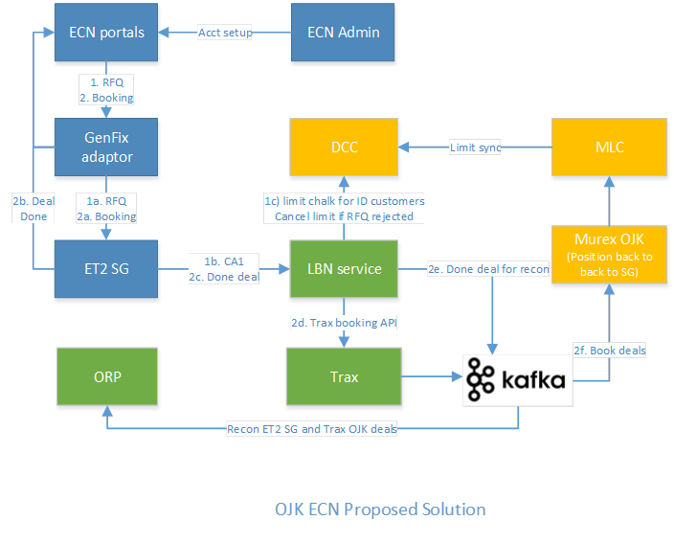
Proposed ECN solution

Slide 15
Proposed ECN solution

